Slide 1
LO-FI PROTOTYPE

Slide 2
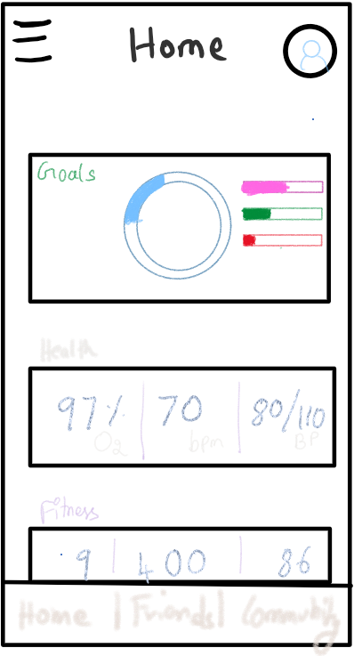
HOME PAGE

Slide 3
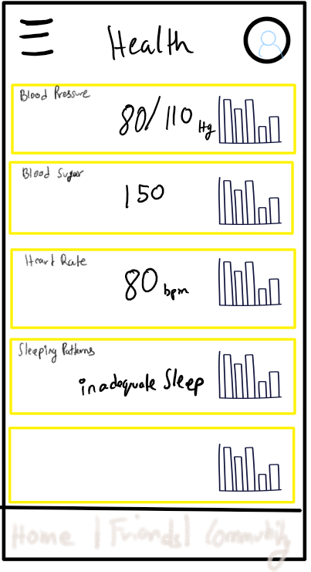
HEALTH MONITORING PAGE

Slide 4
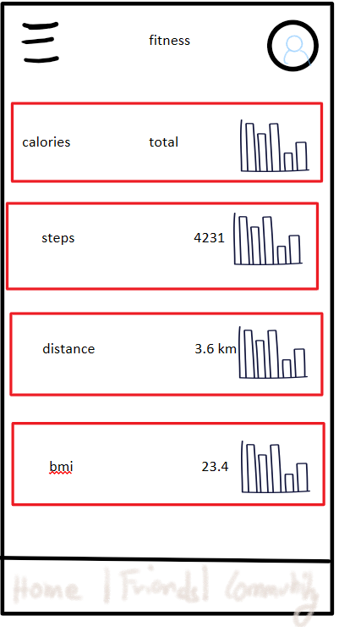
FITNESS MONITORING PAGE

Slide 5
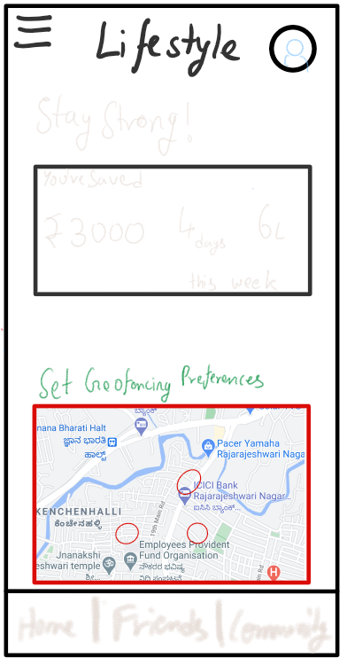
LIFESTYLE PAGE

Slide 6
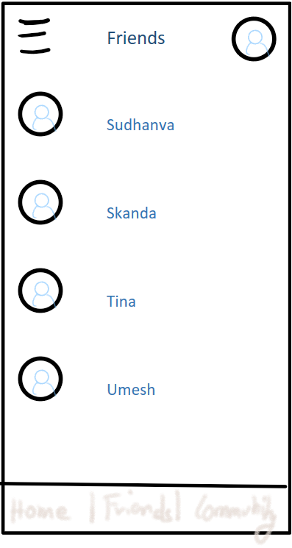
FRIENDS PAGE

Slide 7
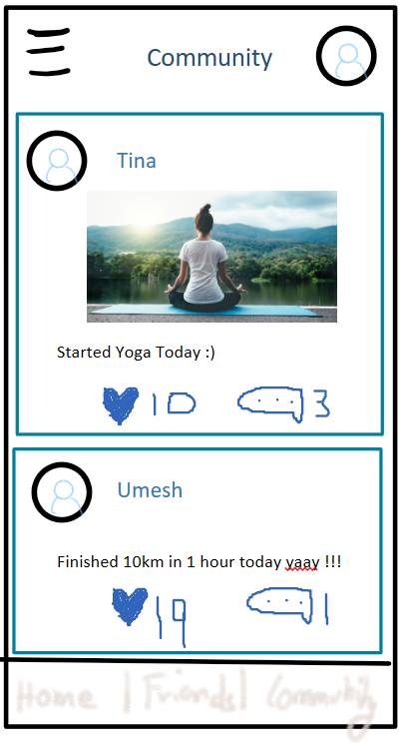
COMMUNITY PAGE

Slide 8
TASKS

Slide 9
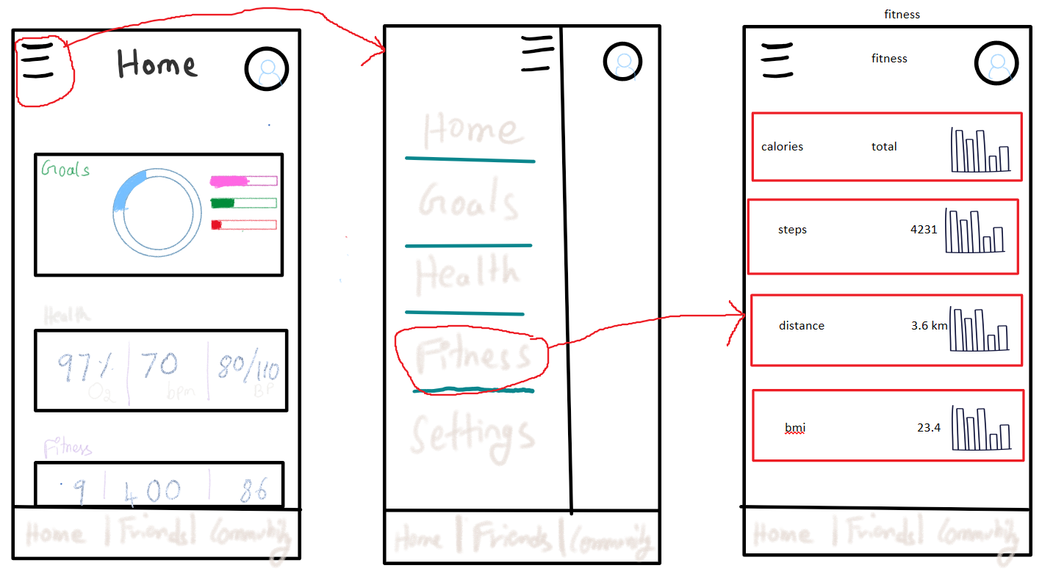
Navigation across different sections

Slide 10
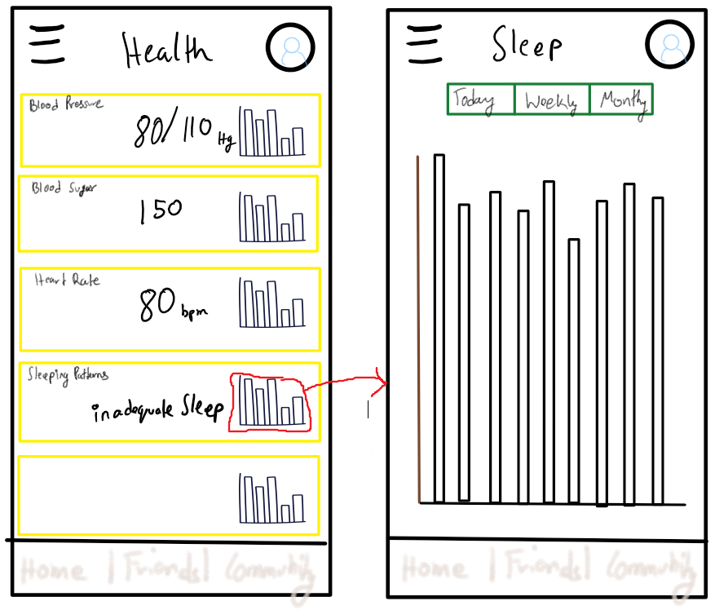
Viewing the graph

Slide 11
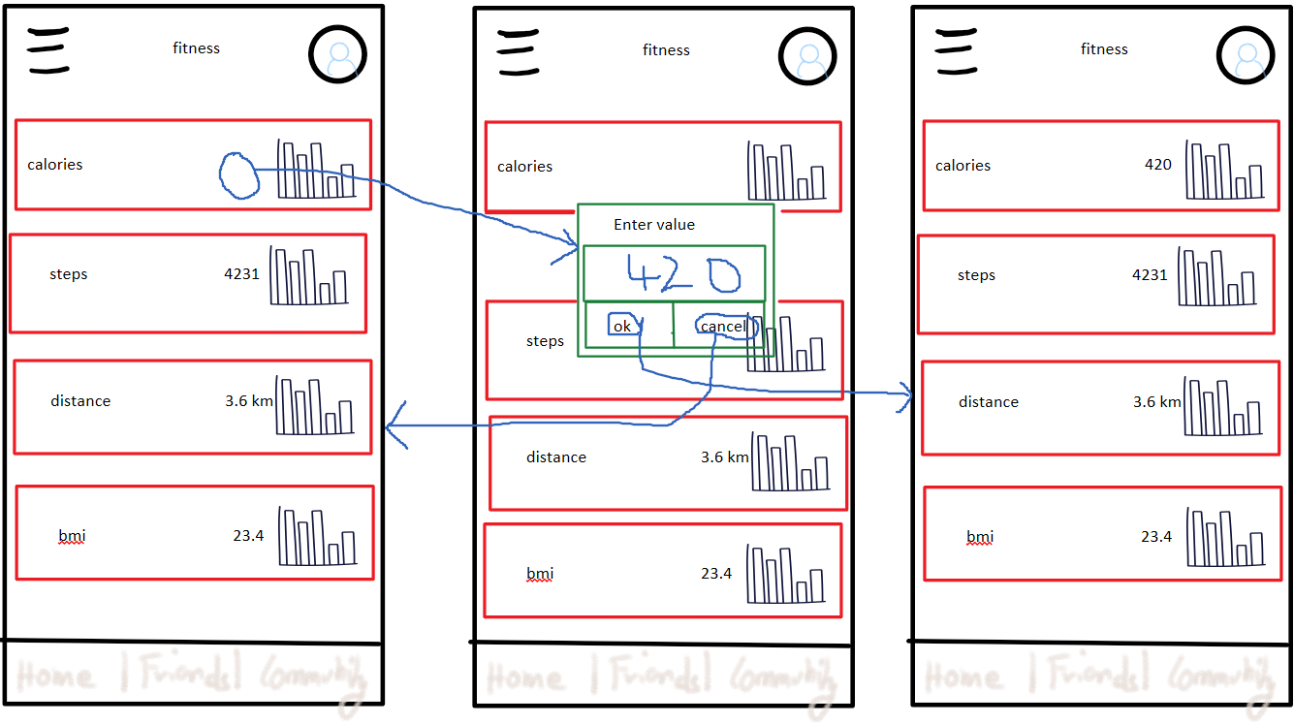
MANUALLY ENTER DATA

Slide 12
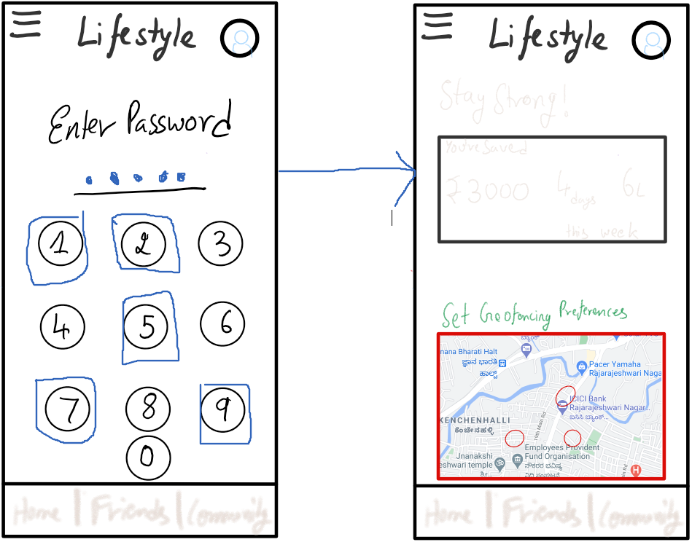
ENTER PASSWORD TO VIEW LIFESTYLE PAGE

Slide 13
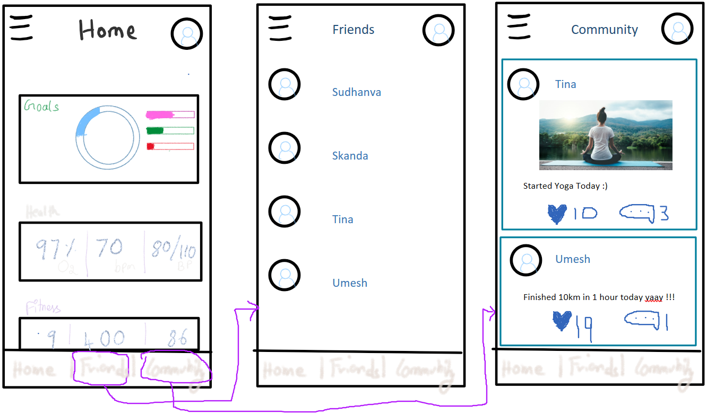
NAVIGATE TO FRIENDS AND COMMUNITY PAGE

